Slide 1
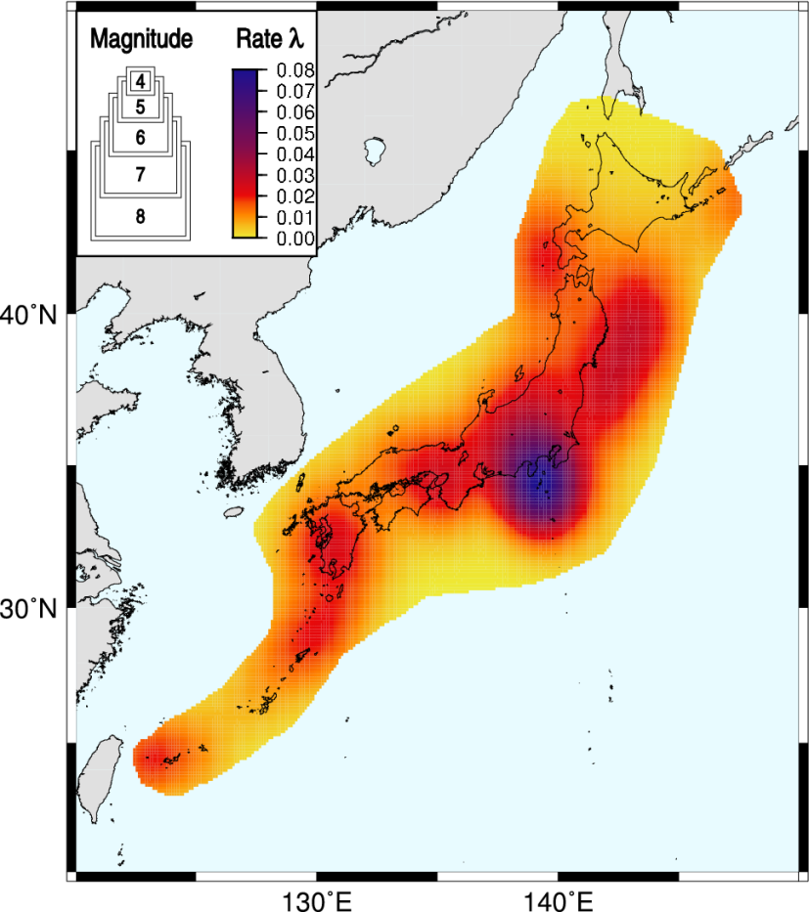
A simple smoothed seismicity forecast for prospective testing in Japan
Jeremy Douglas Zechar
Lamont-Doherty Earth Observatory

Slide 2
Smoothed seismicity
Physical intuition: Earthquakes do not occur at a point, they affect some (unknown) region around the hypocenter/rupture surface.
Mathematical representation: Therefore, each event should be smoothed somehow to represent its influence.
Resulting model: The smoothed seismicity map can serve as a reference model against which to compare more complex models.

Slide 3
Decisions to make
Functional form of smoothing kernel
  Shape (power law, Gaussian, Epanechnikov, anistropic)
  Smoothing lengthscale
  Magnitude dependence
  Time dependence
Declustering
  Declustering itself is a modeling challenge.
  Results may be unstable w/r/t parameter choices.

Slide 4
US National Seismic Hazard Map smoothing
Binned epicenters are smoothed using Gaussian with uniform correlation distance of 50 km, following Frankel, 1995.
Petersen et al., 2008

Slide 5
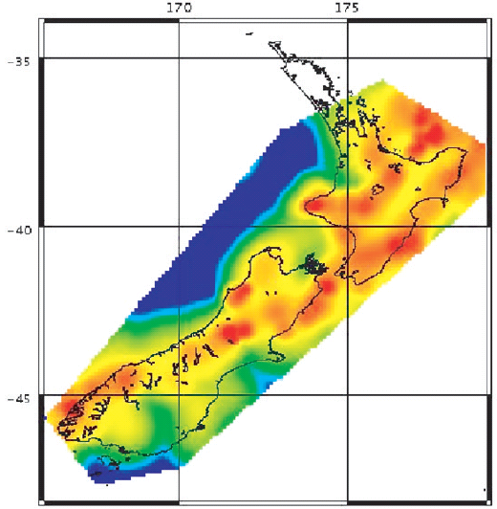
New Zealand NSHM smoothing
Binned epicenters are smoothed using Gaussian with variable lengthscale, dependent on epicentral density, following Stock & Smith (2002).

Slide 6
Kagan & Jackson smoothing
Epicenters are smoothed using a doubly truncated anisotropic power law with directionality based on focal mechanism, following Kagan and Jackson, 1994. Each epicenter’s contribution is also weighted by magnitude and time.

Slide 7
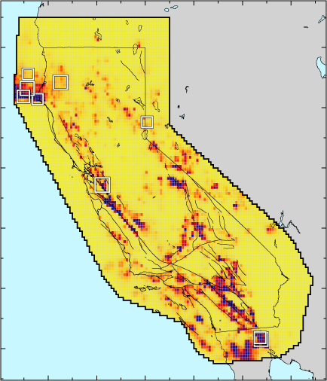
Helmstetter, Kagan, & Jackson smoothing
Extension of Kagan & Jackson method, using smaller events (M>=2 in CA) and an adaptive smoothing lengthscale (Helmstetter et al. 2007)

Slide 8
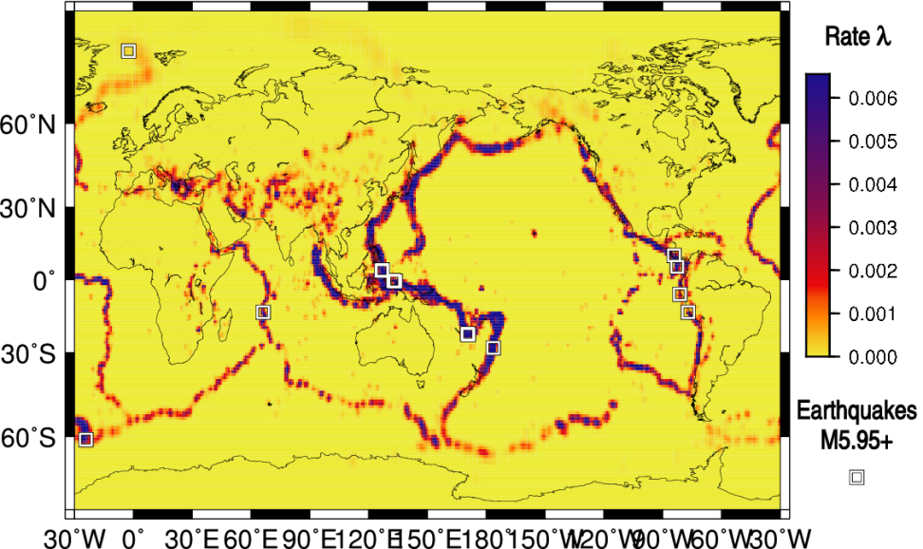
Zechar Simple Smoothed Seismicity (Triple S)
Gaussian kernel, fixed bandwidth, isotropic, time-invariant, magnitude-invariant
  Bandwidth optimized using retrospective experiment
Applied globally, currently under prospective test

Slide 9
Binary prediction, binary outcome
Hit
Miss
False alarm
Correct negative
Alarm
Negative alarm
Space
Time

Slide 10
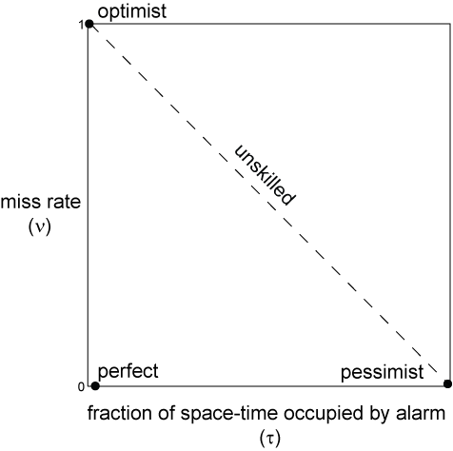
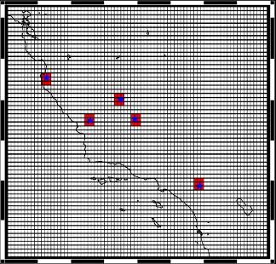
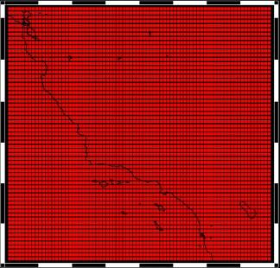
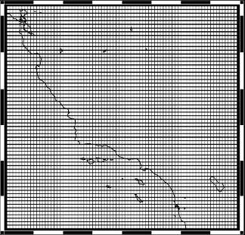
Molchan diagram
Molchan, 1991, Molchan & Kagan, 1992

Slide 11
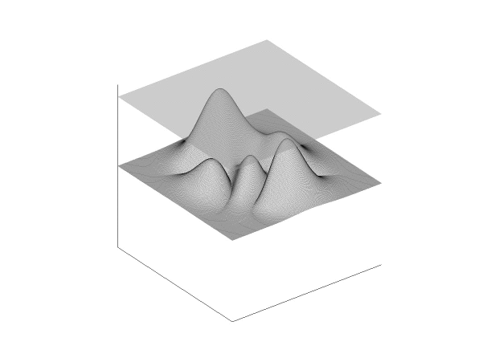

Generalize alarm set to alarm function
Alarm
function
value
latitude
latitude
longitude
longitude

Slide 12
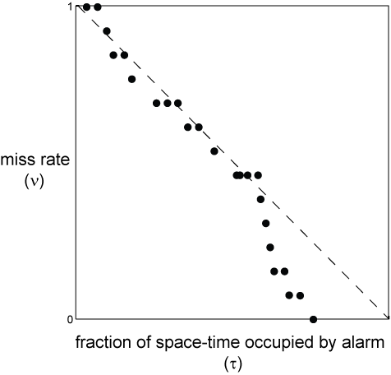
Molchan diagram
Molchan trajectory: collection of (τ,ν) points generated from alarm function
Potential for ambiguity

Slide 13
Area skill score
Area above a Molchan trajectory, cumulative measure of performance for a given alarm function f(x):
Reference model p(x) is used to define measure of space in computing τ.
  Typically, reference model is based on historical distribution of seismicity.
  In the case when p(x) is very good, a_{f}(1) → ½ for all f(x).
~
~
Zechar & Jordan, 2008

Slide 14
Emphasis on reference model
One can pose the problem of earthquake prediction as the search for the distribution of seismicity, p(x).
To measure the utility of a given earthquake prediction, one can compare the predicted distribution with the observed distribution, relative to a reference model, p(x).
Understanding of earthquake predictability can progress through iterative improvement of the reference model.
~

Slide 15
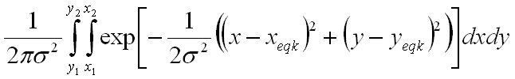
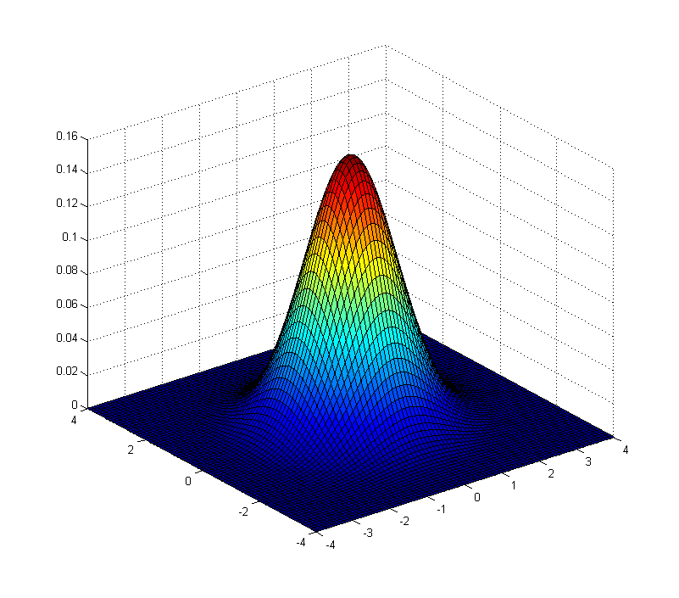
Optimization using area skill score
Consider a very simple class of forecasts:
  Smoothed seismicity, single lengthscale parameter
  Gaussian kernel, lengthscale σ, K_{σ} :

Slide 16
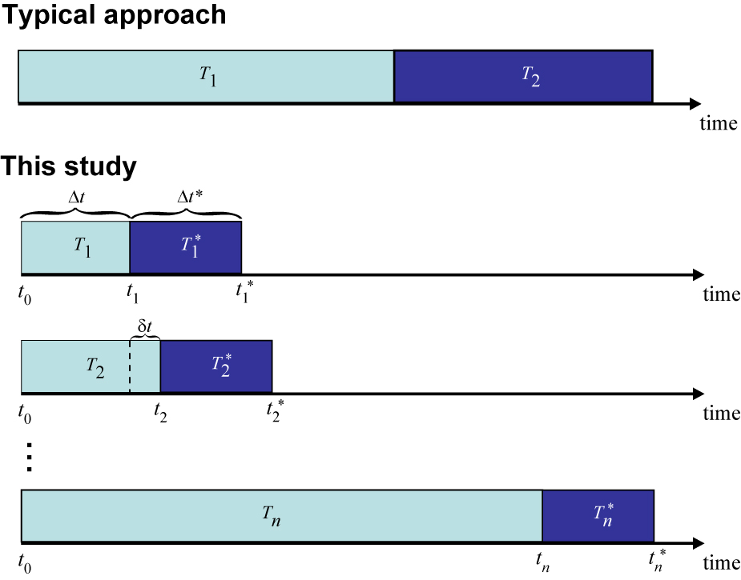
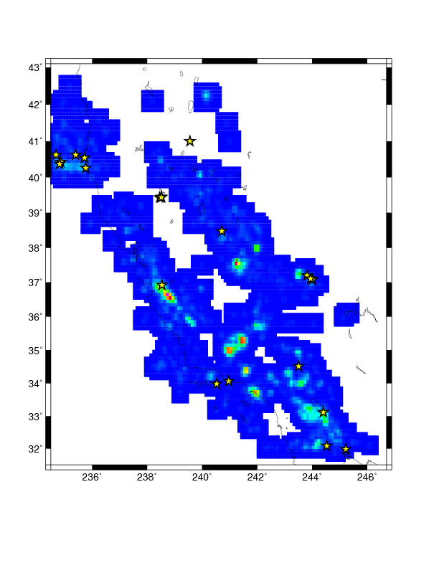
Optimization experiment
Consider a very simple class of forecasts:
  Smoothed seismicity, single lengthscale parameter
  Gaussian kernel, lengthscale σ
We smooth a set of eqks in a learning period to forecast target eqks in the test period.
  Vary the value of σ.
  Determine the optimal value of σ for this learning period.
Goal: to construct an optimized reference model for prospective experiments

Slide 17
Optimal value of σ
Each value of σ corresponds to a unique alarm function, a candidate reference model.
The best reference model is the one which brings all others closest to a_{f}(1) = ½. This is measured by minimizing the average misfit:

Slide 18
Predictability experiment
Consider Σ = {5,10,20,25,30,50,75,100,200} km
Target earthquakes: M_{JMA} ≥ 3.95
Study region: Japan
Smooth M_{JMA} ≥ 1.95 eqks, 1 Jan 2000 to 31 Dec 2003
Test period: 1 Jan 2004 to 31 Dec 2007

Slide 19
Optimization results
(km) χ
==============
5 0.320
10 0.306
20 0.261
25 0.236
30 0.220
50 0.180
75 0.155
100 0.165
200 0.194

Slide 20

Resultant prospective
forecast
Testing began 1 Sep 2008
and will continue for 1 yr.
Simple Smoothed Seismicity (Triple S) model is also under test in California, Western Pacific and Global testing regions.

